Slide 1
Automatic Undo for Cloud Management via AI Planning

Slide 2
1 Introduction
The facility to rollback a collection of changes, i.e., reverting to a previous acceptable state, a checkpoint, is widely recognised as valuable support for dependability.(like deleting a disk volume in a production environment)
Sagas : To undo the effects of a sequence of operations, the system executes the corresponding compensating actions in the reverse order.
(not always feasible on cloud platforms)
Use an AI planner to automate discovering an appropriate sequence of available operations from an API, in order to rollback to a checkpoint.

Slide 3
2 Motivating Examples
Example 1.
The apparent compensator operation does not always reverse a forward operation.
Example 2.
Executing compensator operations in reverse chronological order does not result in a sequence of operations being undone.
Example 3.
The best undo sequence is not a reverse se- quence of compensators.

Slide 4
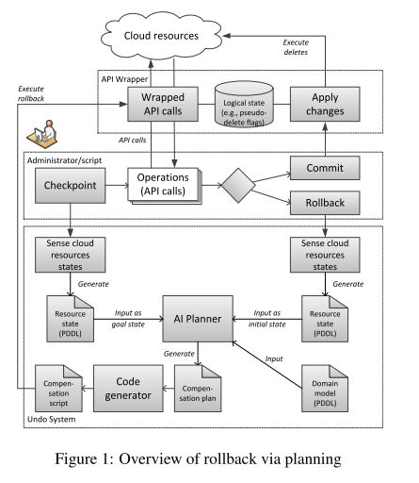
3 System Design

Slide 5
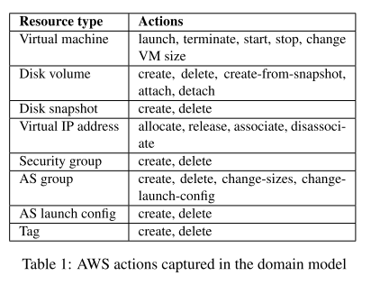
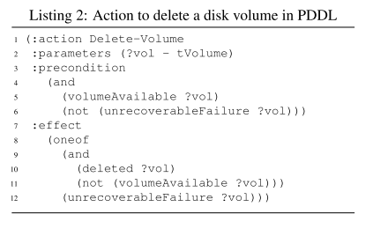
4 Domain Model and its Use

Slide 6
5 Experiments
Case Study:
rollback planning scenario. Assume a rollback is desired after Step 8 , the copying step.
The initial state is the following: volumes V1,V2 are in use, V0 exists but is not in use; snapshot S0 is deleted; mover instances MS,MD are running; V1 is attached to MS, V2 is attached to MD.
The goal state, to revert back to before Step 1 was executed, is therefore: V0 exists but is not in use; V1,V2,S0 are deleted; MS,MD are stopped.

Slide 7
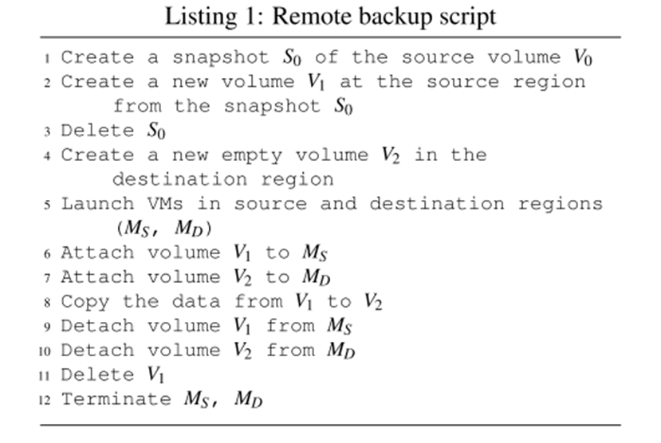
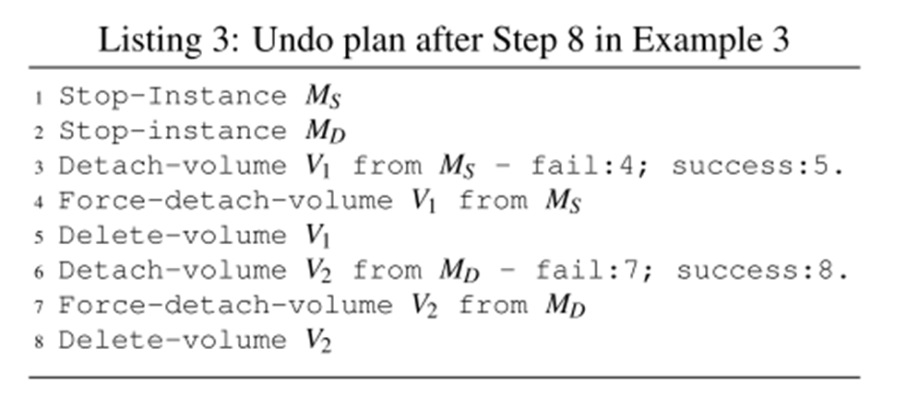

Slide 8
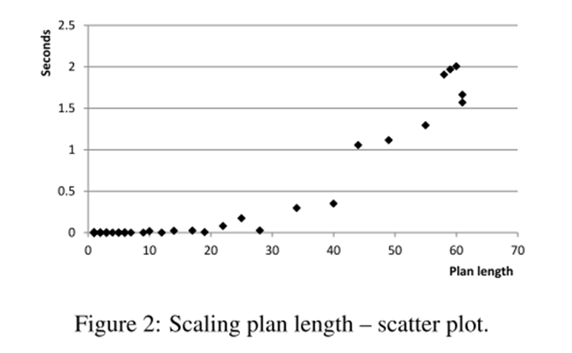

Slide 9
https://www.usenix.org/conference/hotdep12/workshop-program/presentation/Weber

